Slide 1

1
Notes:
REPEAT_FOR_GRAPHS

Slide 2
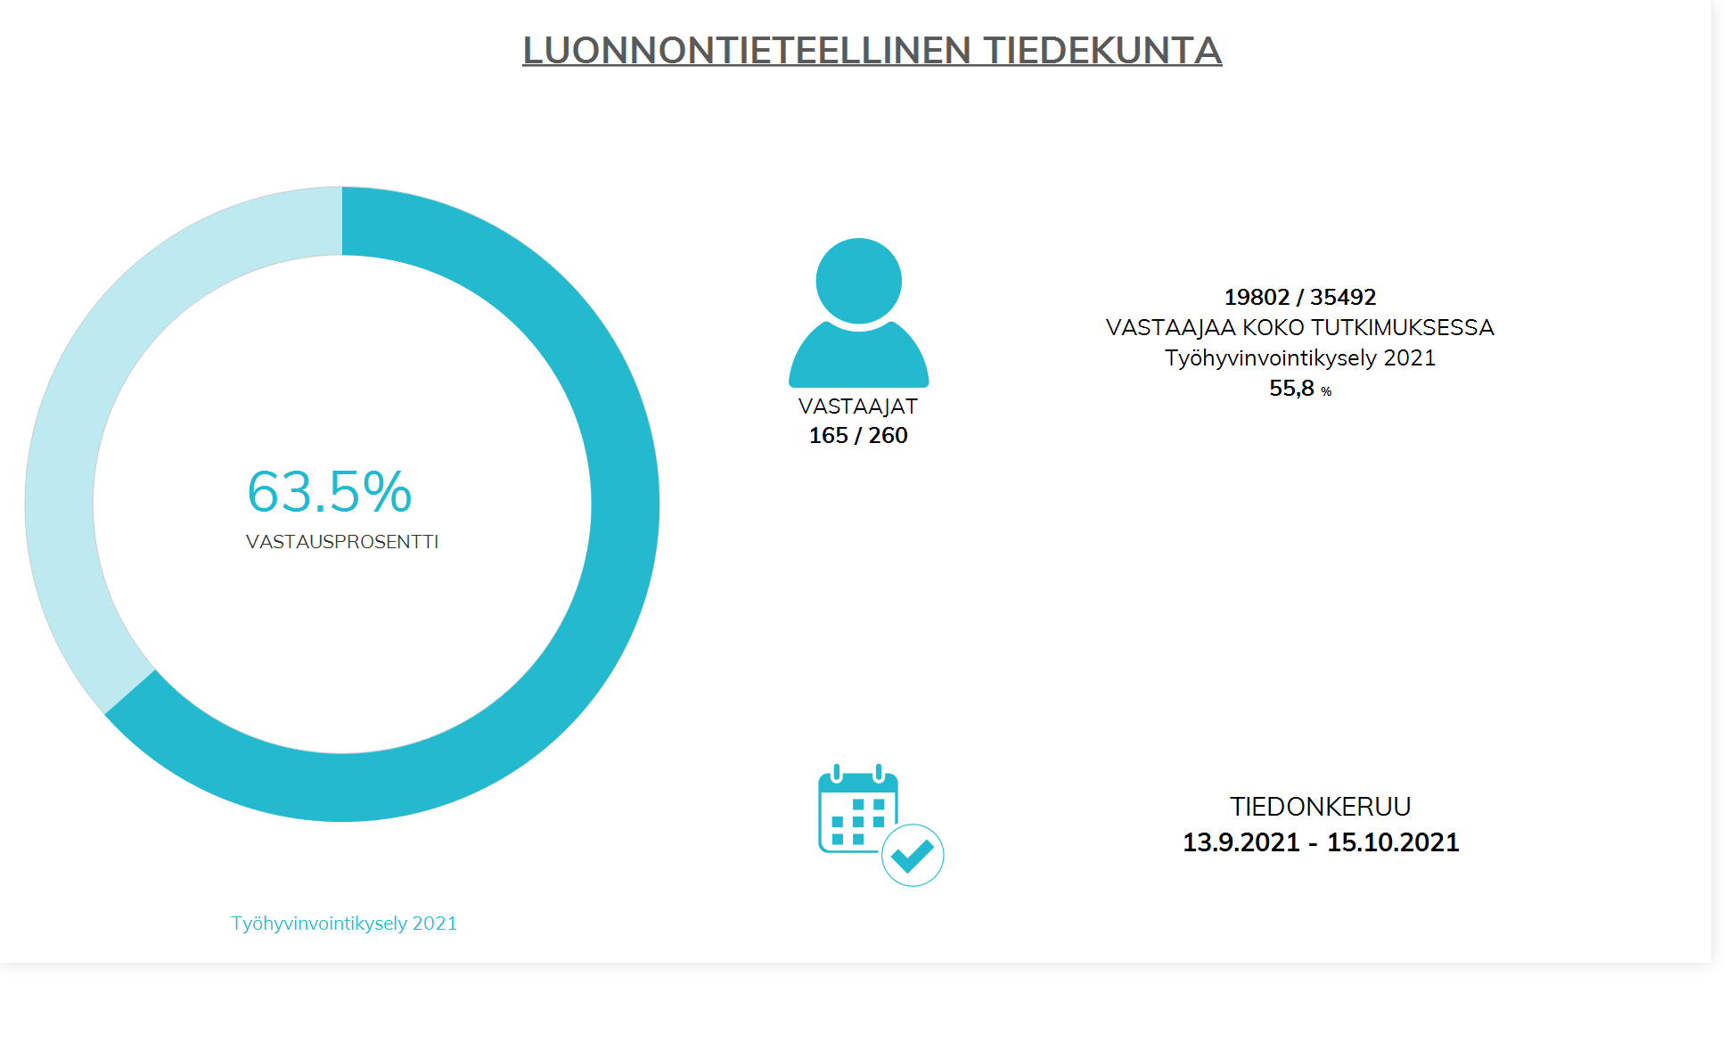
2
Notes:
REPEAT_FOR_GRAPHS

Slide 3
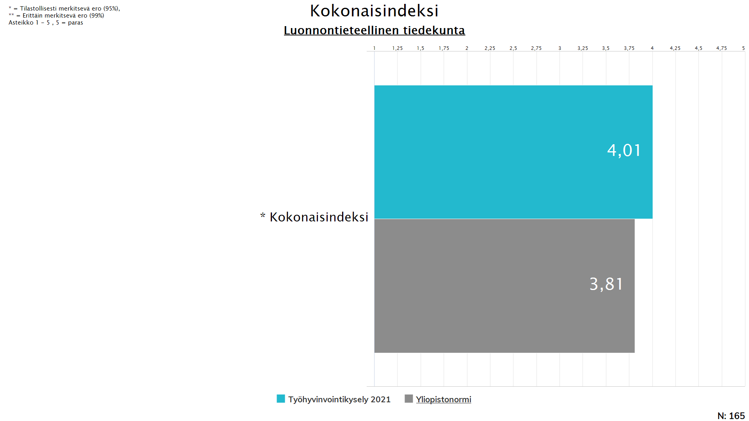
3
Notes:
REPEAT_FOR_GRAPHS

Slide 4
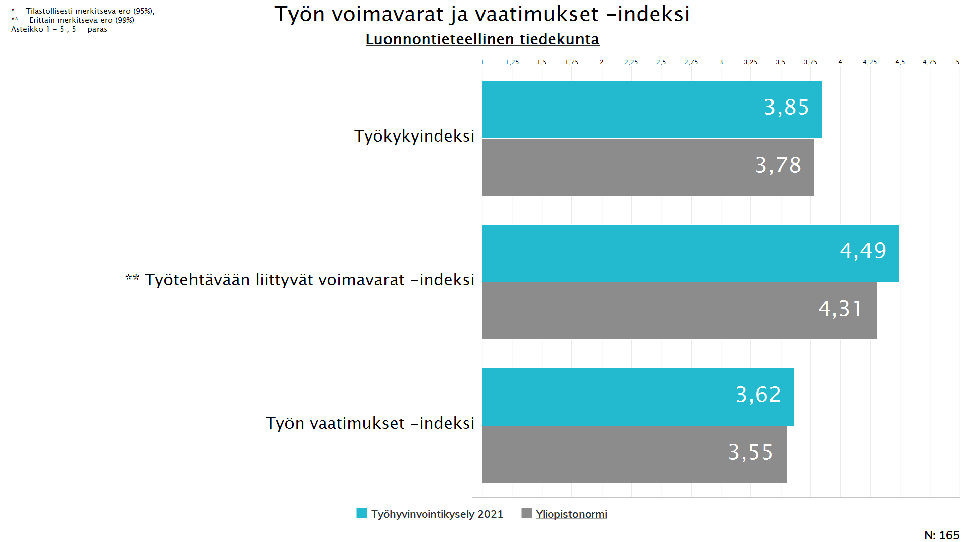
4
Notes:
REPEAT_FOR_GRAPHS

Slide 5
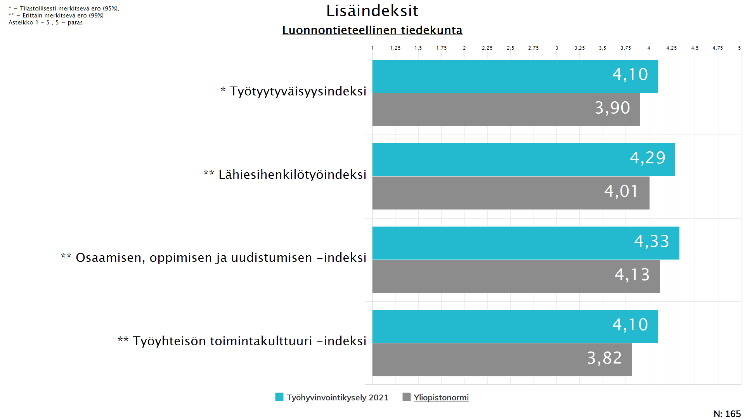
5
Notes:
REPEAT_FOR_GRAPHS

Slide 6
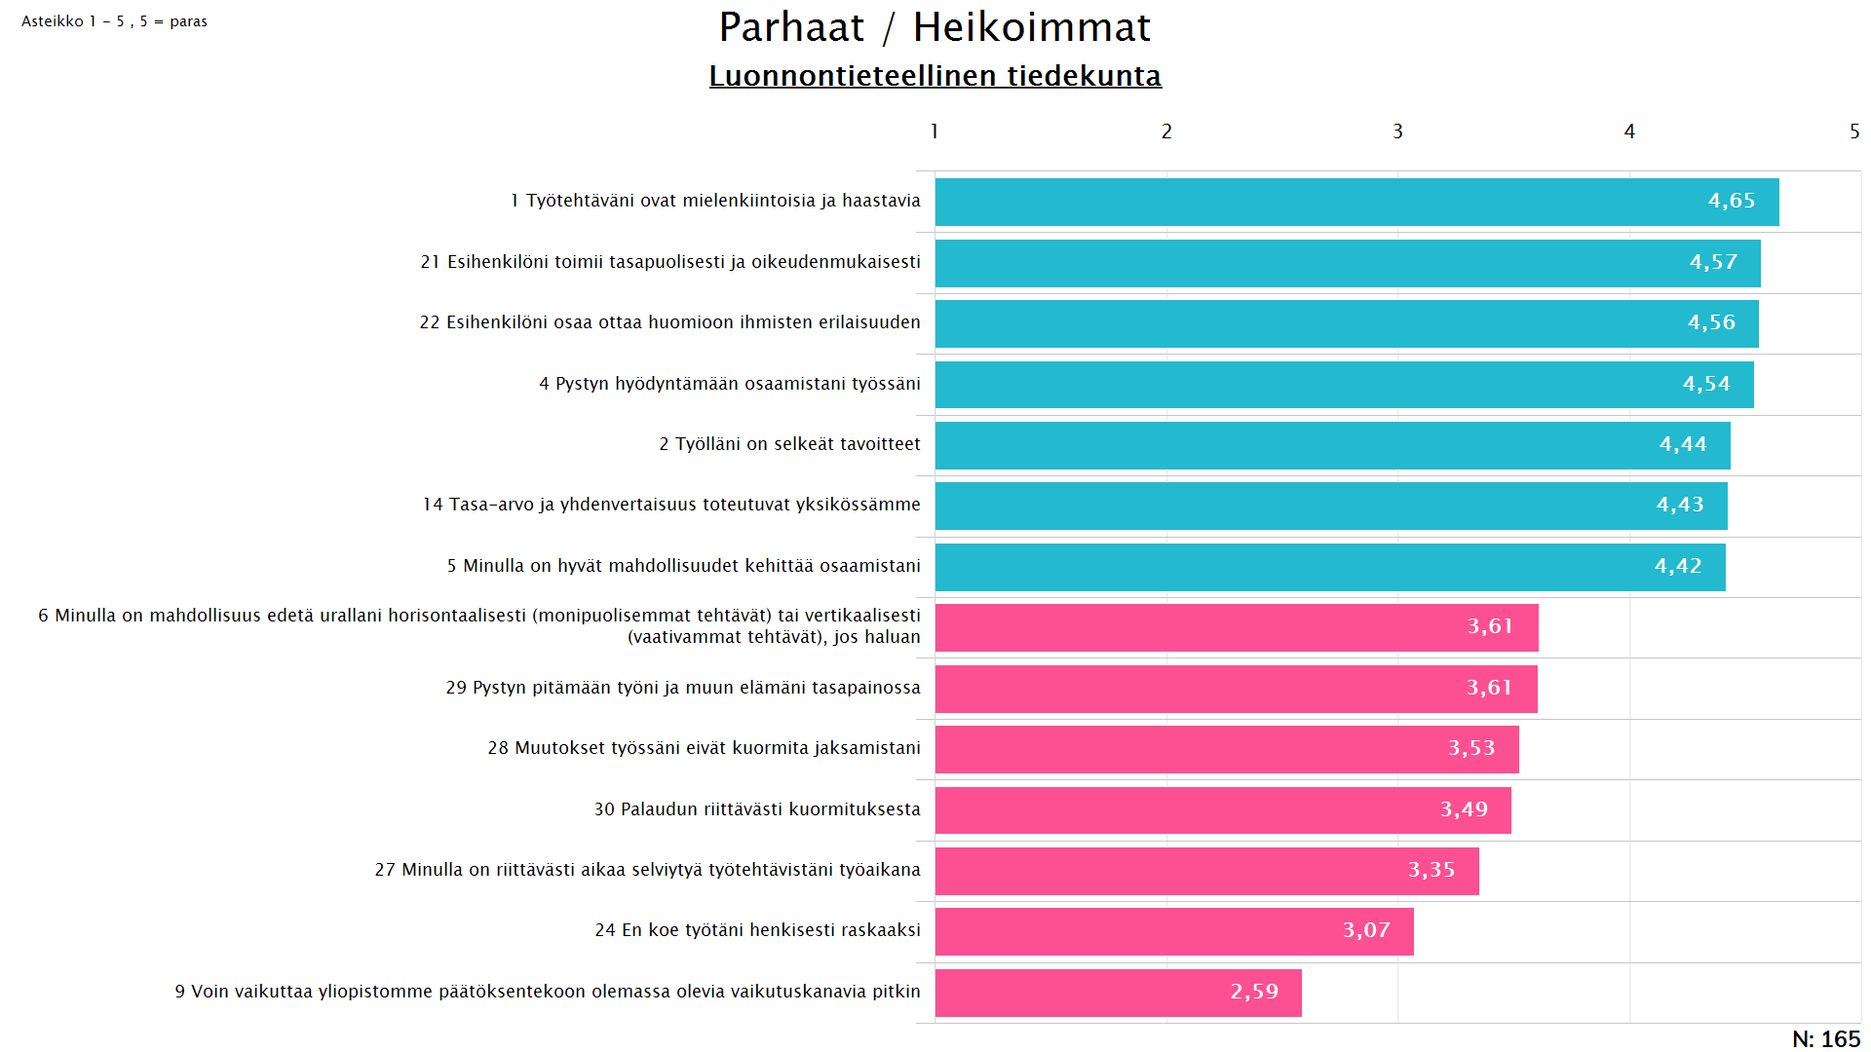
6
Notes:
REPEAT_FOR_GRAPHS

Slide 7
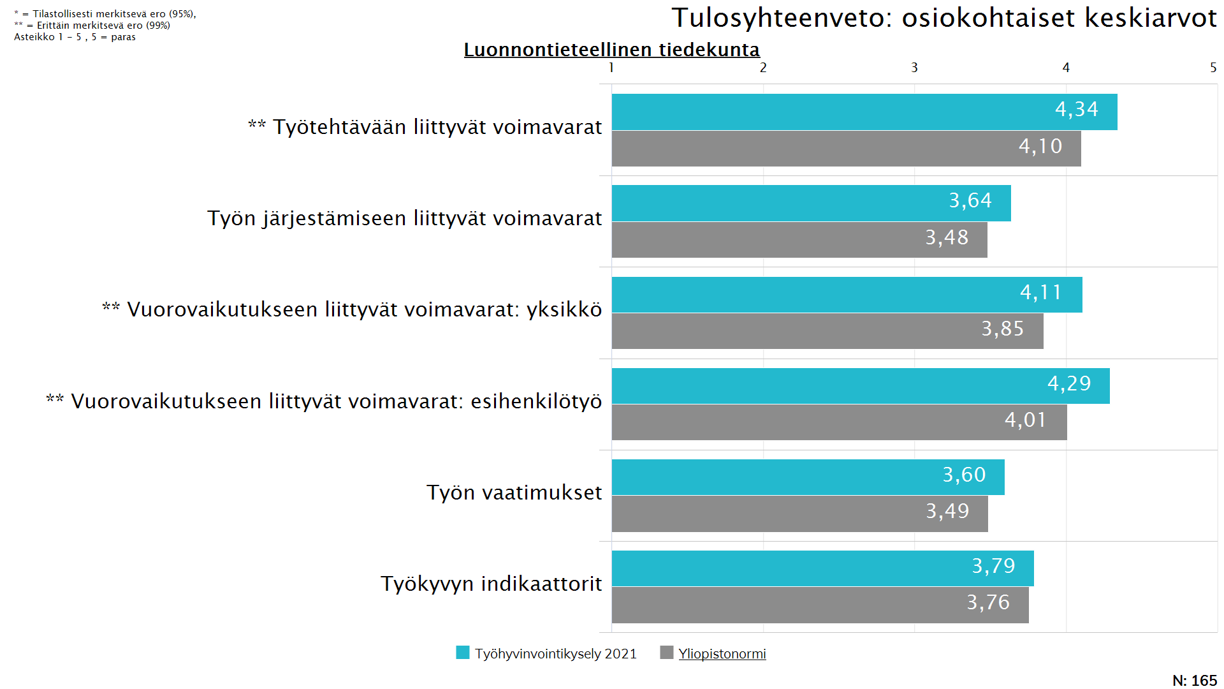
7
Notes:
REPEAT_FOR_GRAPHS

Slide 8
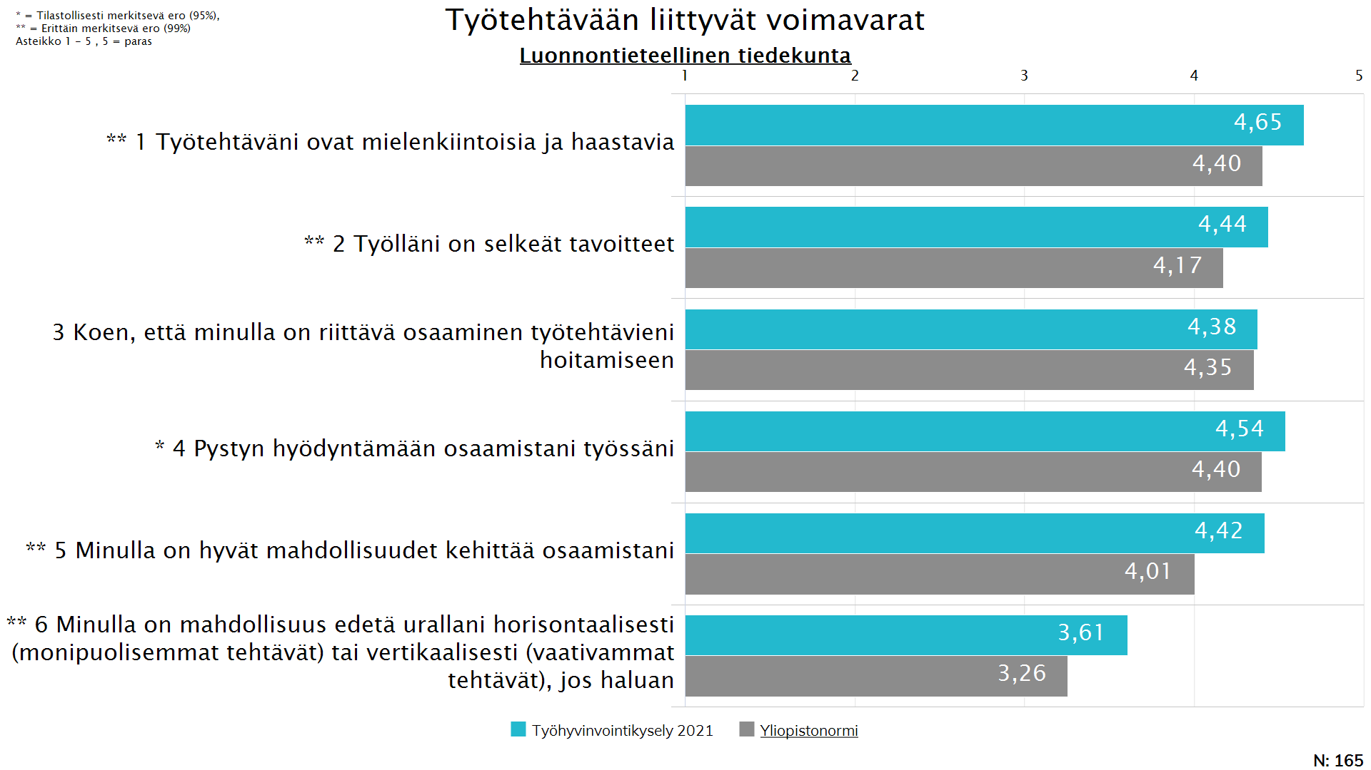
8
Notes:
REPEAT_FOR_GRAPHS

Slide 9
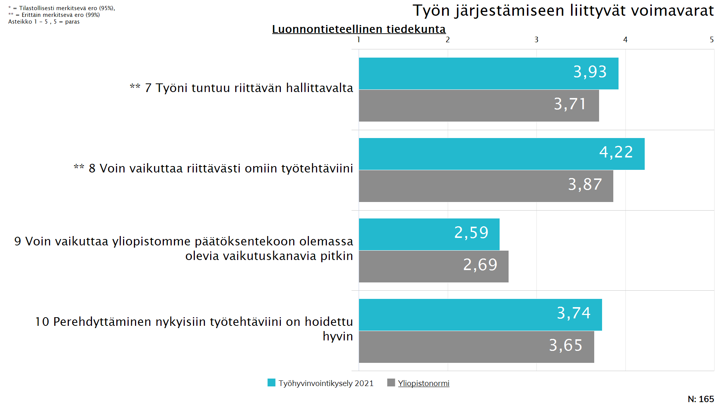
9
Notes:
REPEAT_FOR_GRAPHS

Slide 10
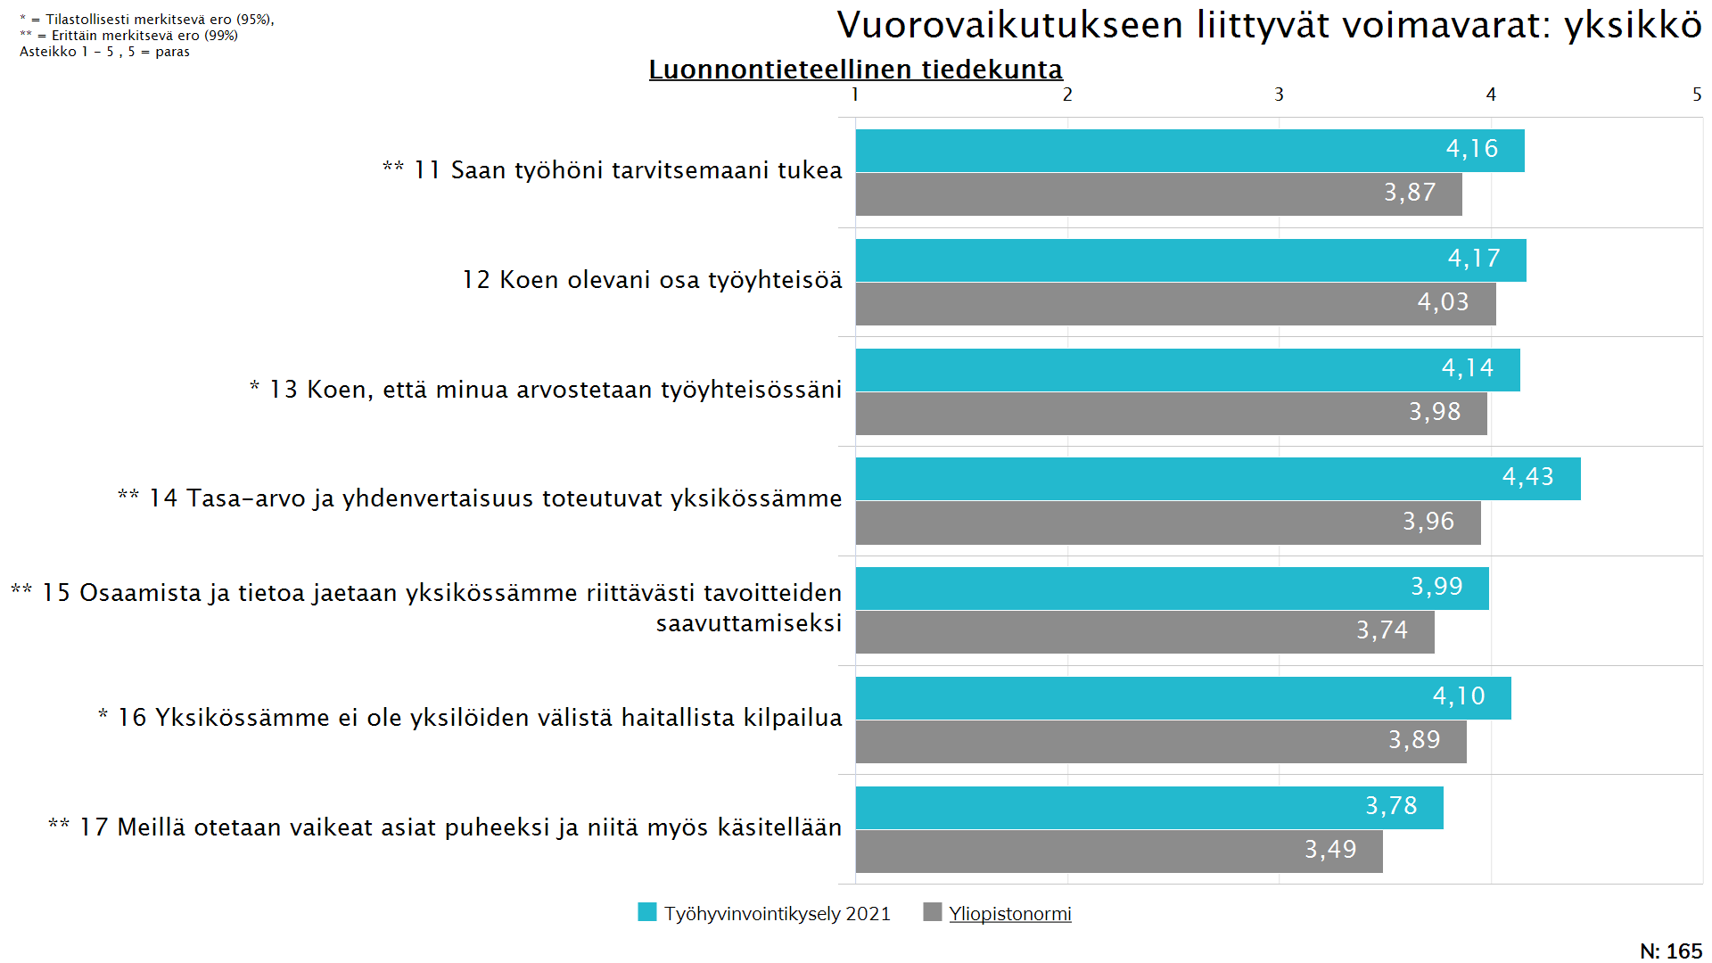
10
Notes:
REPEAT_FOR_GRAPHS

Slide 11
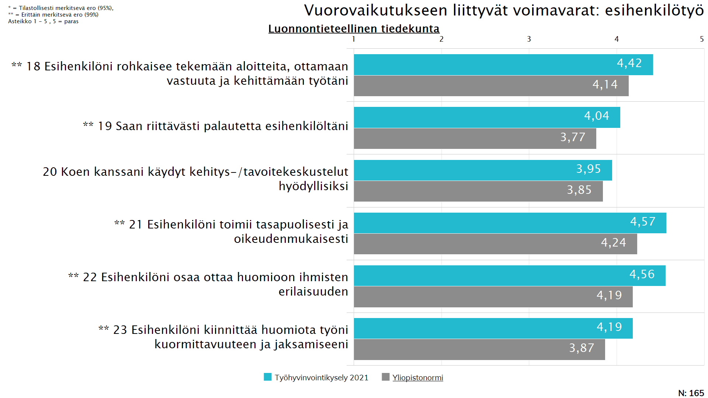
11
Notes:
REPEAT_FOR_GRAPHS

Slide 12
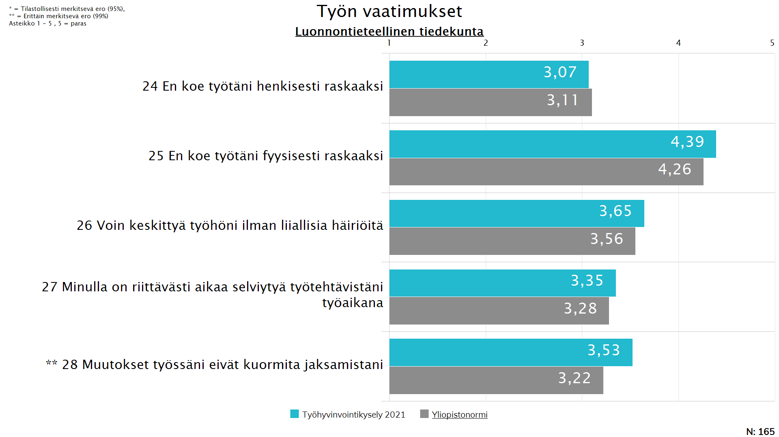
12
Notes:
REPEAT_FOR_GRAPHS

Slide 13
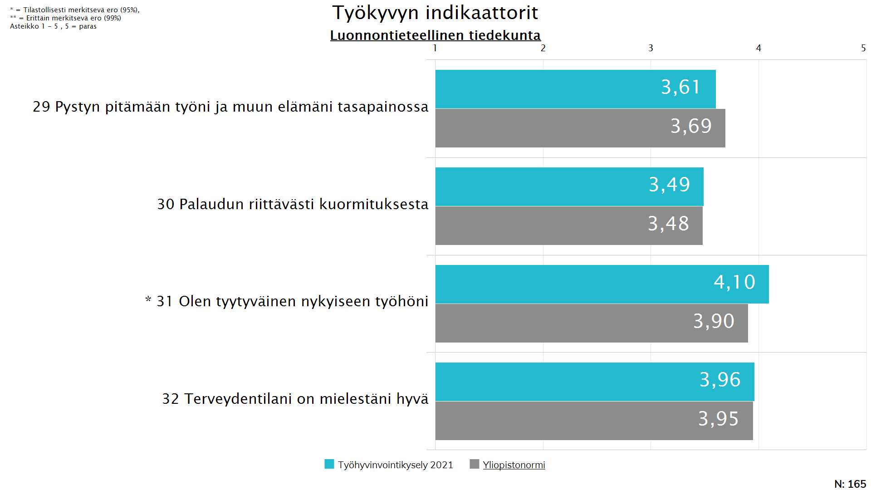
13
Notes:
REPEAT_FOR_GRAPHS

Slide 14
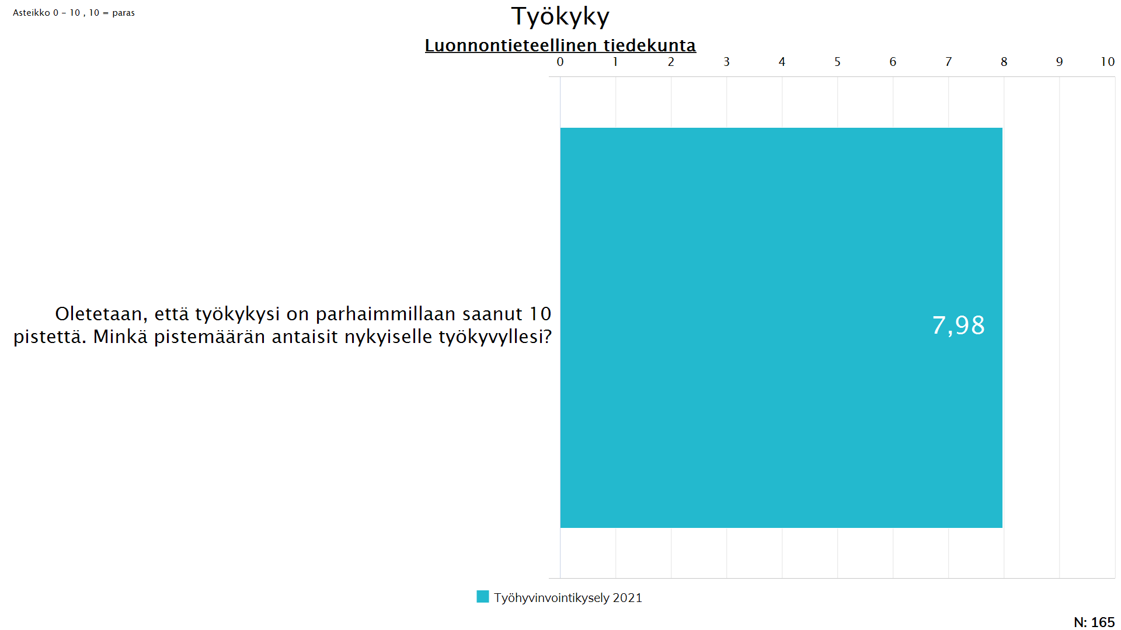
14
Notes:
REPEAT_FOR_GRAPHS

Slide 15
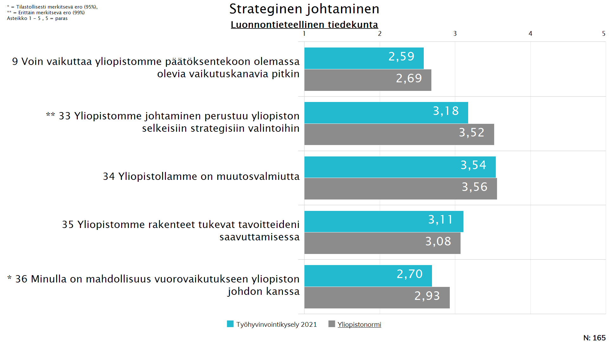
15
Notes:
REPEAT_FOR_GRAPHS

Slide 16
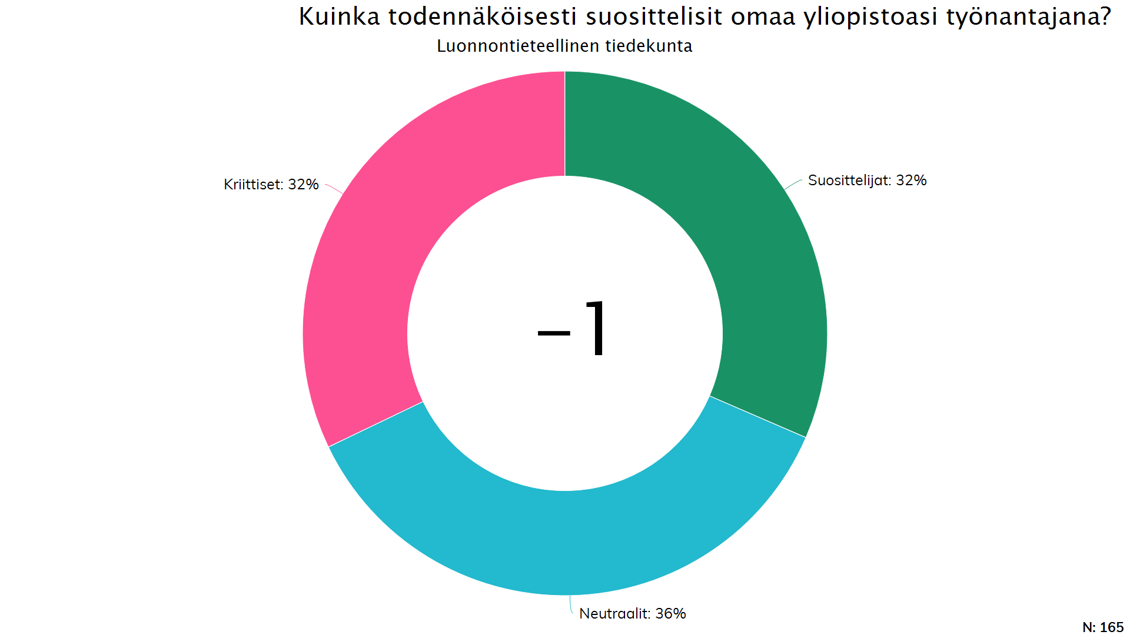
16
Notes:
REPEAT_FOR_GRAPHS

