Slide 1


I4WORLD
Imaging and Characterisation for a Sustainable World
Infosession 16.9.2022
HORIZON-MSCA-2021-COFUND-DP I4WORLD – grant agreement preparation phase

Slide 2
I4WORLD in short
I4WORLD - Imaging and Characterisation for a Sustainable World – is a new doctoral programme at the University of Oulu (UOULU)
November/2022 - October/2027
Involving 6 faculties and 24 research units, 18 academic partners, 10 private companies, 7 other organizations
Funding 25 Early-Stage Researcher (ESR) positions with duration of 48 months
Monobeneficiary doctoral programme coordinated and implemented by UOULU
Co-funded by European Commission Marie Skłodowska-Curie
EU Contribution to funding 3.34 M€
Call for ESR positions open: 1.11.2022-31.1.2023
International
Interdisciplinary
Intersectoral

Slide 3
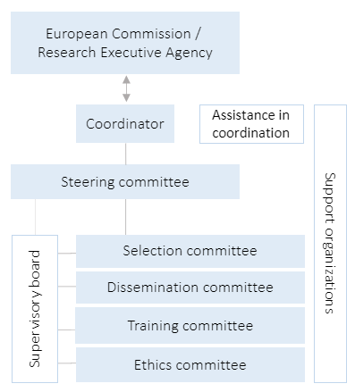
Organisation
Head: Marko Huttula
Vice head: Simo Saarakkala
Coordinator: Henna Longi
Selection committee: Teija Kekonen (University of Turku)
Dissemination committee: Satu Ojala
Training committee: Timo Fabritius
Ethics committee: Riitta Keiski
Assistant: Marjut Saastamoinen
UniOGS: Heli Ruotsalainen, Karita Saravesi
HR: Päivi Rundgren, Outi Tolonen
Finance: Emilia Kokko, Jouni Tyni

Slide 4
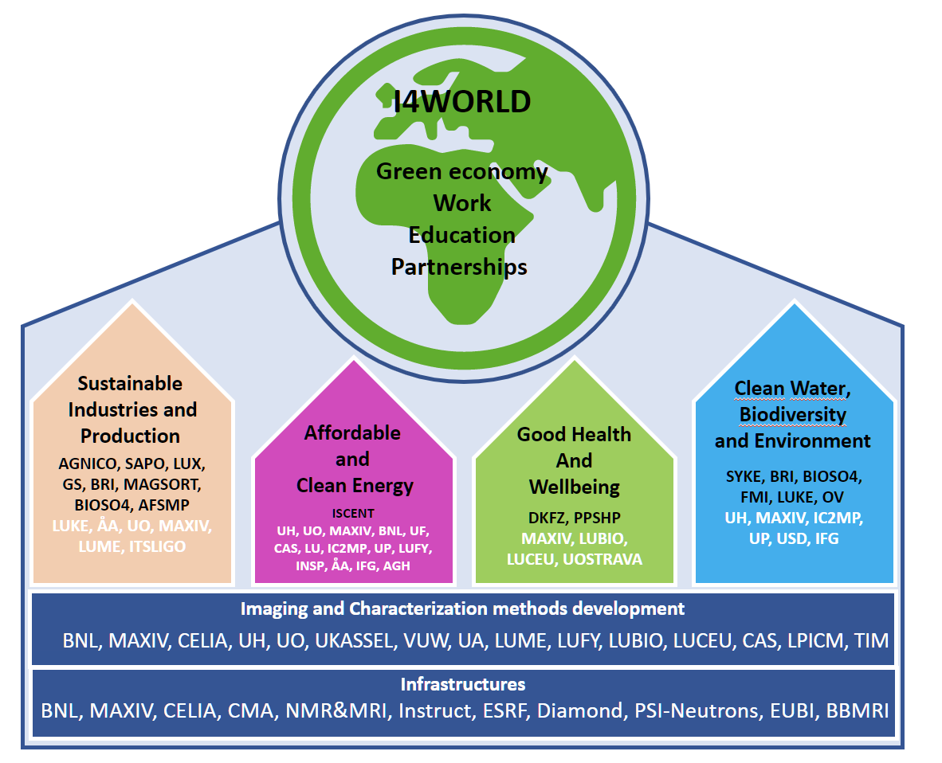
SYNOPSIS:
I4WORLD
Imaging and Characterisation for a Sustainable World
Will train 25 ESRs with comprehensive understanding on sustainability (environmental, economic and social)
Is driven by 18 international universities, 5 research organisations and 10 private companies from chemistry to medical industries and appliance manufacturing, two public organisations and Association of Finnish Metal Producers
Is based on taking the benefits of novel imaging and characterisation methods beyond the traditional borders between research fields to the sustainable world
Advances the UN’s SDG topics of Good Health and Wellbeing, Affordable and Clean Energy, Sustainable Industries and Production, and Clean Water, Biodiversity and Environment
Is positioned under the umbrella of the University of Oulu Graduate School (UniOGS)
Carries special requirements and actions beyond standard doctoral training (both for ESRs and supervisors)

Slide 5
SYNOPSIS:
I4WORLD
Imaging and Characterisation for a Sustainable World
Utilises local, national and international strengths concerning ecosystems and partners: excellence in research, local to European-level cutting-edge infrastructures, collaboration networks and secondments, dissemination and outreach
Linking interdisciplinary knowledge and research capabilities in novel imaging and characterisation to find solutions to global challenges and boost the achievement of the UN’s SDGs
Builds on a critical mass of interdisciplinary, intersectoral and international expertise and provides a unique combination of complementary methodological approaches in a high-quality training programme that would be impossible to implement in any of the research units or Partner Organisations on their own
Creates a training network to educate ESRs on unique interdisciplinary skills in research methodologies and inbuilt capabilities of innovative thinking towards potential benefits and sustainability in a wide context
Offers ESRs the opportunity to undertake research in private and public ecosystems and to work closely with large companies, SMEs and academia. Tailored secondments and customised training are valuable assets for ESRs.

Slide 6
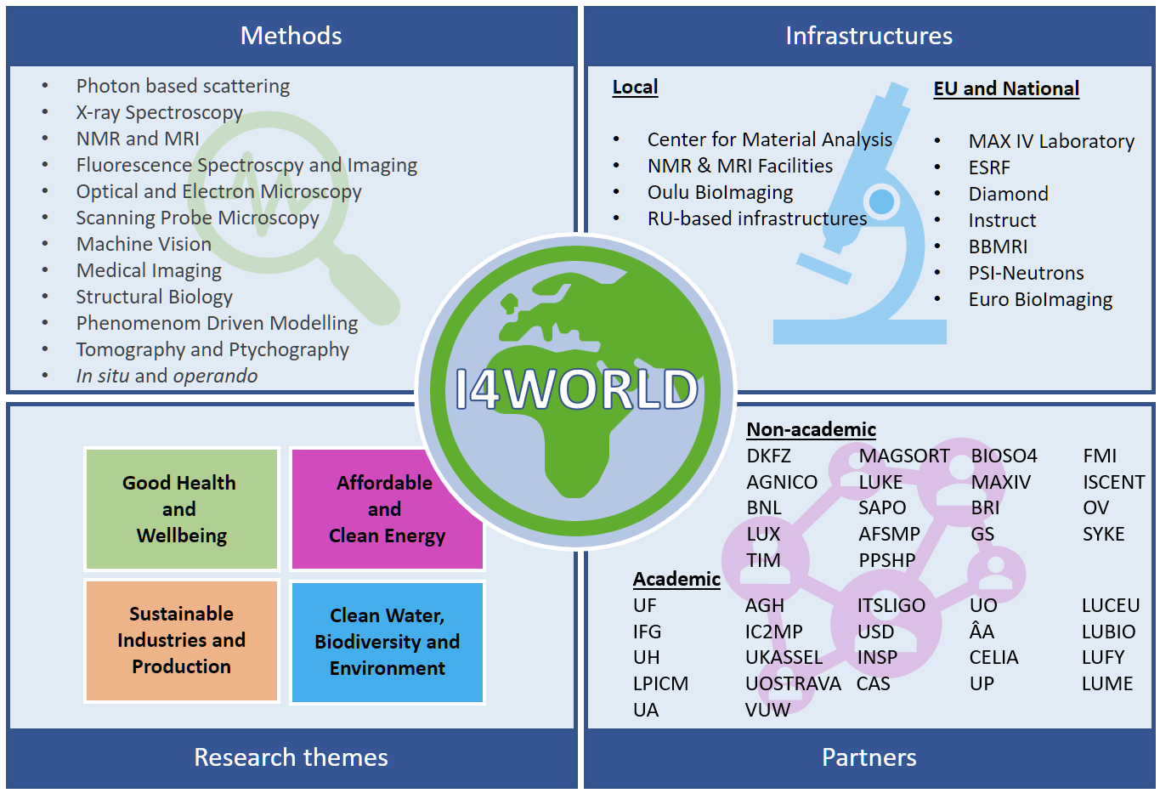

Slide 7
I4WORLD outcome
ESRs:
first-hand experience of how research develops from basic science findings to interdisciplinary innovations
Unique knowledge of modern imaging and characterisation methods with capabilities for identifying and solving industrial-scale problems beyond standard engineering approaches.
Stakeholders:
Talented individuals for future research and as innovation leaders.
Knowledge of materials from atomic to macroscopic scales
Wider use and development of novel methodologies and infrastructures
interdisciplinary sustainability knowledge
Strengthen the skills and position of UOULU as a provider of world-class doctoral education

Slide 8
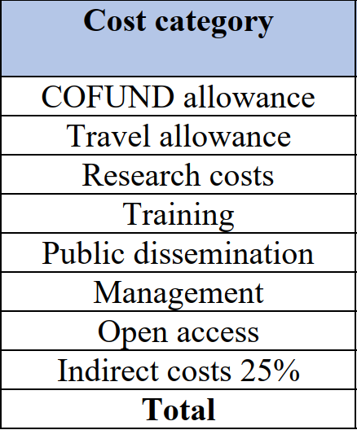
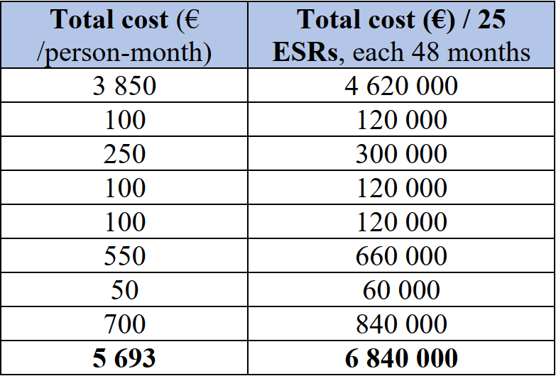
Funding model (as applied from EU)
Cofunding from EU
Overhead 25% of EU funding
Participating RUs 600 000 €
University of Oulu 51% total

Slide 9
In practice
Grant agreement in preparation, DOA not finalized
Programme is assumed to be co-funded by UOULU
Supposed to start 1.11.2022
I4WORLD as project in Faculty of Science
Project support part of related common activities e.g. related to UniOGS and I4WORLD actions
Participating RU’s perspective:
ESRs recruited in RU’s
Forepersonship and supervision in RU’s
100% SOLE to project for 48 months (i.e. 0-cost to RU)
4800€ travel funding / ESR (paid by programme)
RU’s required to provide Research Costs 250€/month/ESR (Facilities, computer, laboratory costs, infrastructure access,…)
(As known 15.9.2022)
On-going:
Dialogue to:Rectorate, Finance, Project coordination, HR, UniOGS, UIC, Communications…
Budgeting
DoA and GA preparation
Guidelines and website preparation
Call preparation
Committee building
…

Slide 10
UOULU research units
Faculty of Science
Nano and Molecular Systems (NANOMO)
Ecology and Genetics (EG)
Mathematical Sciences (MATH)
Nuclear Magnetic Resonance (NMR)
Space Physics and Astronomy (SPA)
Faculty of Biochemistry and Molecular Medicine
Disease Networks (DN)
ECM-Hypoxia (ECMH)
Protein and Structural Biology (PSB)
Oulu Business School
Marketing, Management and International Business (MMI)
Faculty of Medicine
Clinical Neuroscience (CN)
Health Sciences and Technology
Faculty of Information Technology and Electrical Engineering
Biomimetics and Intelligent Systems Group (BISG)
Center for Machine Vision and Signal Analysis (CMVS)
Centre for Wireless Communications – Radio Technologies (CWC-RT)
Oulu Advanced Research on Service and Information Systems (OASIS)
Optoelectronics and Measurement Technologies (OPEM)
Faculty of Technology
Environmental and Chemical Engineering (ECE)
Fibre and Particle Engineering (FPE)
Industrial Engineering and Management (IEM)
Materials and Mechanical Engineering (MME)
Oulu Mining School (OMS)
Process Metallurgy (MET)
Sustainable Chemistry (SusChem)
Water, Energy and Environmental Engineering (WE3)

Slide 11
Partners
Partner Organisation name | Partner Organisation short name | Country
AGH University of Science and Technology | AGH | PL
Agnico Eagle Finland | AGNICO | FI
Association of Finnish Steel and Metal Producers | AFSMP | FI
Atlantic Technological University (FNA ITSligo) | ITSLIGO | IE
BioSO4 | BIOSO4 | FI
Brightplus | BRI | FI
Brookhaven National Laboratory | BNL | US
Centre Lasers Intenses et Applications | CELIA | FR
Chinese Academy of Sciences | CAS | CN_X_HK
Finnish Environment Institute | SYKE | FI
Finnish Meteorological Institute | FMI | FI
German Cancer Research Center | DKFZ | DE
GrainSense | GS | FI
Insitut de Chimie des Milieux et Matériaux | IC2MP | FR
Institut NanoSciences de Paris | INSP | FR
Instituto Federal de Goias | IFG | BR
Iscent | ISCENT | FI
LPICM, Ecole Polytechnique | LPICM | FR
Lund University | LU | SE
Luxmet | LUX | FI
Magsort | MAGSORT | FI
MAX IV | MAXIV | SE
Natural Resources Institute Finland | LUKE | FI
Nothern Ostrobothnia Hospital District | PPSHP | FI
Oulun vesi | OV | FI
Sapotech | SAPO | FI
Timegate Instruments | TIM | FI
University of Aston | UA | UK
University of Fribourg | UF | CH
University of Helsinki | UH | FI
University of Kassel | UKASSEL | DE
University of Oslo | UO | NO
University of Ostrava | UOSTRAVA | CZ
University of Poitiers | UP | FR
University of Southern Denmark, Odense | USD | DK
Victoria University of Wellington | VUW | NZ
Åbo Akademi | ÅA | FI
Partners listed at the application phase
Programme welcomes new partners
Final active partners depend on selected ESR projects
Partners do not have right to charge costs or claim contributions
EU Large Scale Enterprises (staff >250, turnover > 50M€ or Balance >43M€) are subject to committing co-finance of 30 600 € / ESR project
Partners will offer secondment positions for ESRs and participate to training

Slide 12
Projects
The I4WORLD Programme comprises four research themes aligned with the UN’s SDGs:
  Good health and Wellbeing
  Affordable and Clean Energy
  Sustainable Industries and Production
  Clean Water, Biodiversity and Environment
Research themes will include a portfolio of potential research projects for the candidates.
Project descriptions are available for the applicants at UOULU webpage
The candidate may also freely propose a project, indicating a potential research site from UOULU
Table Research themes and examples of research projects for ESR candidates
Research theme | Potential research projects (examples)
Good Health and Wellbeing | Biomarker and biosensor development Development of wearable sensors Medical spectroscopy
Affordable and Clean Energy | Solar photocatalytic hydrogen production Synchrotron in-situ techniques in development of energy nanocatalysts Power-to-fuel technologies for CO₂ reduction
Sustainable Industries and Production | Carbon-free hydrogen reduction steelmaking process characterisation Sustainable utilisation of industrial side streams Commercialisation, productisation and value chain development
Clean Water, Biodiversity and Environment | Measurement of microplastics in water Modelling and assessment of hydrosystems and biodiversity Advanced NMR characterisation of water purification catalytic materials

Slide 13
Project descriptions
Project title
Project description (max 800 characters with spaces)
Related I4WORLD theme(s)
Location of position
Supervisors
Partners
Double degree info
DL. 10.10. to henna.longi@oulu.fi
Remember:
Projects must comply with programme aims
25 projects funded
Projects with application phase partners listed at www
ESR may apply with OWN PROJECT suggestion possibly including new partners
Supervisors may participate in several project descriptions

Slide 14
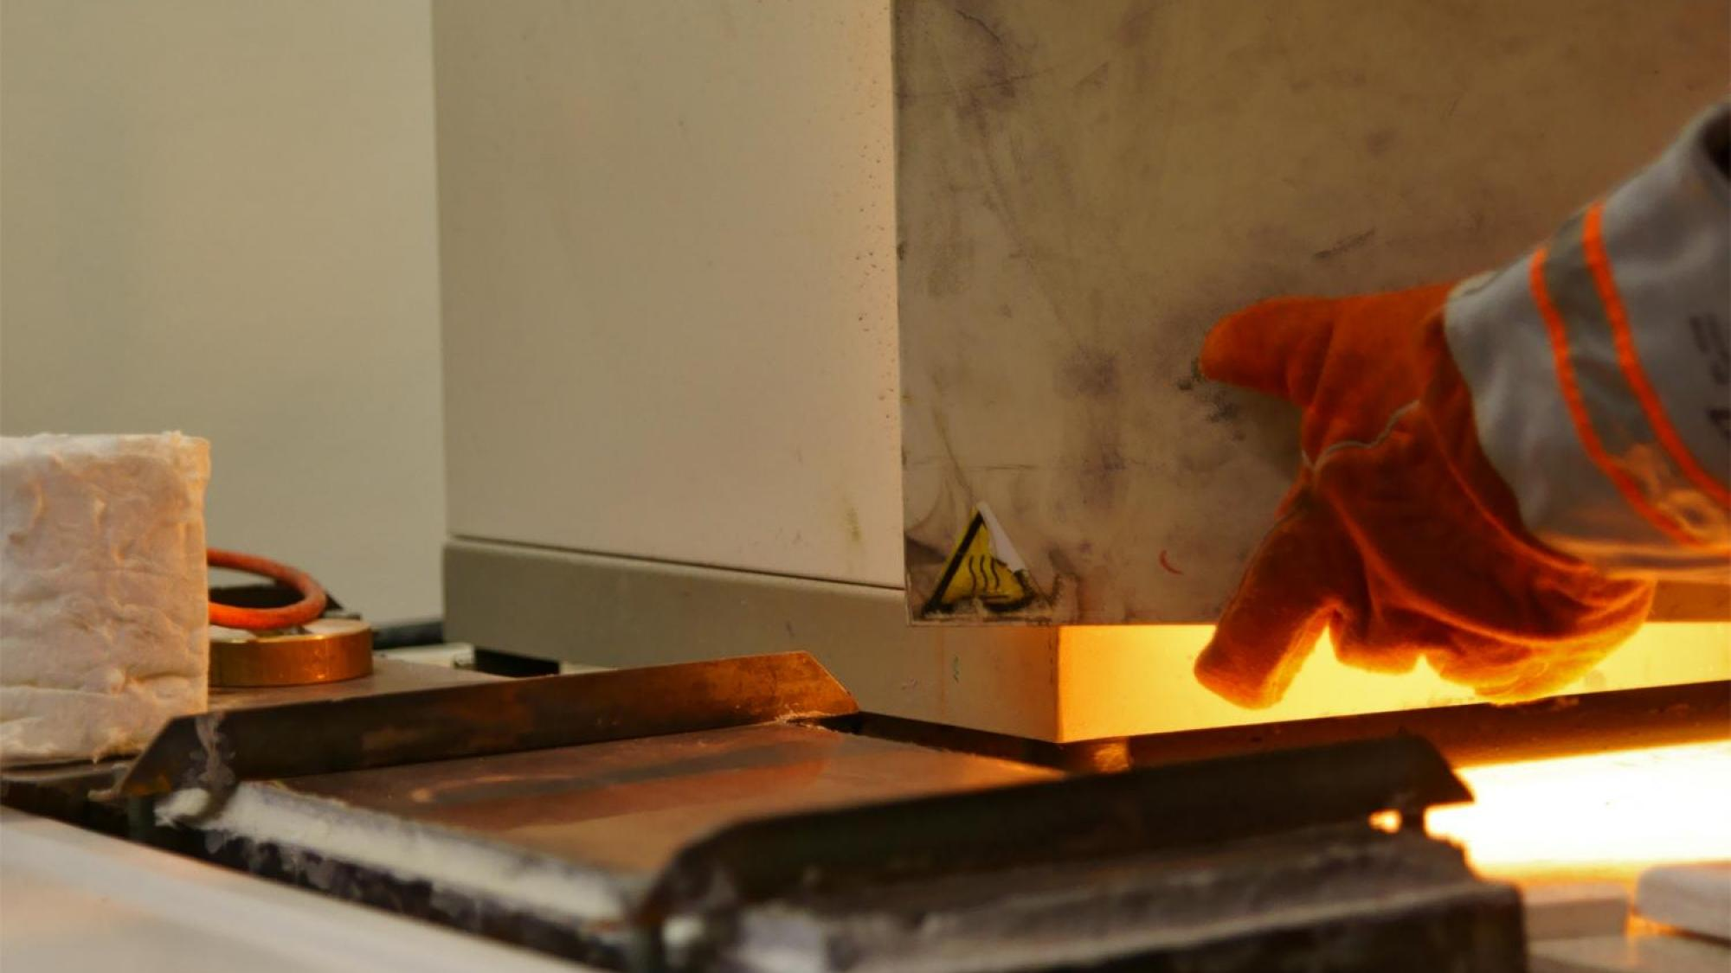
Project description example
Development of sustainable steelmaking processes in hydrogen transition
The steel industry is in a transition phase as it moves towards environmentally friendly steelmaking. In order to achieve the ambitious goals, the role of electric energy in both melting and reduction processes will grow in the near future. The doctoral researcher's research topic is the study of plasmas used in the steel industry, such as the electric arc furnace melting process and the use of hydrogen plasma reactor, as well as their characterization and analysis with optical emission spectroscopy. The goal of the research is to find ways for real-time control of plasma-based applications and optimization of processes.
Related I4WORLD theme: Sustainable Industries and production
Location of position: Process Metallurgy Research Unit
Supervisors: prof. Timo Fabritius, Dr. Henri Pauna, Process Metallurgy Research Unit
Doc. Samuli Urpelainen, Nano and Molecular Systems RU
Mikko Jokinen, Luxmet Inc.
Partners: Luxmet Inc.
Double Degree: No intended Double degree

Slide 15
Early Stage Reseachers
Highly qualified and motivated international students
Early-Stage Researchers (Researchers who, at the time of the recruitment, have not yet been awarded a doctorate degree. Researchers who have already successfully defended the doctoral thesis, but have not yet formally been awarded the doctoral degree are not eligible)
Undertake cross-organizational mobility (minimum of six months) upon appointment to doctoral programme
Secondments to Partner enterprises, research institutions or universities
ESRs hired to University of Oulu Research Units for full four-year period
Double Degrees with Partner universities possible. DD training participation 30 600 €/ESR DD training
Remember:
Min. 6 months mobility period

Slide 16
ESR eligibility
All applicants must fulfil the minimum requirements of the University of Oulu Graduate School (UniOGS)
Candidates must hold a Master's degree or degree (e.g. licentiate) in any of the research areas covered by the I4WORLD programme at the date on, which the call closes, and
be able to demonstrate English language skills
must have achieved a good grade in their degree (i.e. at least 60 % of the maximum grade in both taught courses and the master's thesis).
Double Degree (DD) agreements with Partner Universities in individual projects may have additional requirements.
The ESRs are required to undertake transnational mobility when taking up their appointment, in accordance with the mobility rule of Marie Skłodowska-Curie actions
Mobility rule: must not have resided or carried out their main activity (work, studies, etc.) in the country of the recruiting beneficiary or implementing partner for more than 12 months in the 36 months immediately before the deadline of the co-funded programme's call. Compulsory national service, short stays such as holidays and time spent as part of a procedure for obtaining refugee status under the Geneva Convention are not taken into account.
Remember:
MSCA mobility rule: Max 12 month in previous 36 months before 31.1.2023

Slide 17
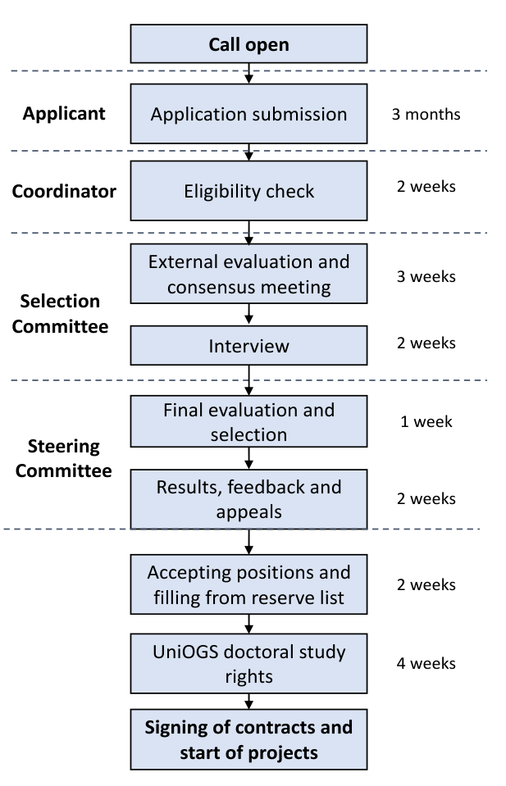
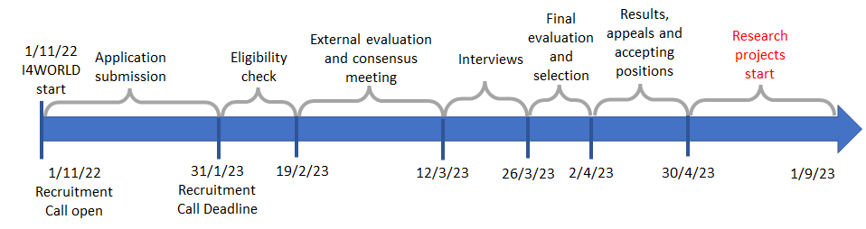
ESR selection timeline
Remember:
External review

Slide 18
ESR evaluation criteria
 | Weight | Points
Quality of the applicant • Prior education and qualifications judged from the curriculum vitae • Grades obtained for previous relevant degree(s), demonstrated in the official transcript of records • Applicant’s motive for research and further training | 50 % | 1-10
Quality of the research proposal • Connection to the programme themes/targets • Originality of the approach • Potential impact on the research field and associated fields • Feasibility of the project in the proposed time • Embedding of interdisciplinary aspects in the project • Intersectoral exposure • International mobility plan | 30 % | 1-10
Compatibility of the applicant with the host • Matching between candidate’s profile, research unit, research project and Partner Organisation(s) | 20 % | 1-10
Remember:
Applicant competence is central
Written evaluation score definitions are as follows: 1: Proposal fails to address criteria, 2: Poor, 3:
Satisfactory, 4: Below average, 5: Average, 6: Above average, 7: Good, 8: Very good, 9: Excellent, 10: Outstanding

Slide 19
Training
 | Main Training Events & Conferences | ECTS (if any) | Lead Institution | Action Month (estimated)
 | Mandatory courses at UniOGS:
1 2 3 4 | Introduction to Doctoral Training Scientific Research and Ethics Doctoral training plan Follow-Up Group meetings and reporting (3-4 times during the programme) | 1 2 3 1 | UOULU
 | Mandatory courses for ESRs in I4WORLD programme
5 | Multidisciplinary imaging methods, principles and applications: 1st intensive course: Imaging and characterisation methods, theoretical principles and applications 2nd intensive course: Methods for image and spectral data analysis and interpretation 3rd intensive course: Future perspectives for imaging and characterisation methods | 5 | UOULU | M20 M32 M44
6 | How to take actions towards sustainable development? | 5 | UOULU | M30
7 | Field-specific studies (requirements according to the discipline) |  | UOULU
 | Training in transferable skills
8 | Diversity and gender balance in science | 1 | UOULU | M12, 36
9 | Dissemination and Communication training | 4 | UOULU | M13, 25, 37, 49
10 | From research ideas to business | 5 | UOULU
11 | General and transferable skills and training by UniOGS | 0.5-2 | UOULU
 | Conferences
12 | Multidisciplinary Imaging Conference |  | UOULU | M48
Committee chair: Timo Fabritius

Slide 20
The Multidisciplinary imaging methods, principles and applications (5 ECTS)
1st Intensive course: Objectives: Understanding principles of electromagnetic radiation interaction with matter, principles of electronic, vibrational, and nuclear magnetic resonance spectroscopies, the use of imaging (MRI, CT, X-Ray, optical, electron, and scanning probe microscopies, Atomic Probe Tomography), the principles of diffraction methods, use of Fourier Transform methods, application of various of SR techniques, possibilities of different methods and the latest developments. Imaging and characterisation methods in applied sciences: combining methods. Sample preparation techniques and effect of samples/matrices on measurement/imaging possibilities and results. Practical limitations. Requirements for on-line measurements. Requirements for medical measurement and imaging. Examples of quantitative analysis of data. Lecturers in charge: M. Huttula, V.-V. Telkki, I. Meglinski, T. Fabritius, S. Saarakkala, L. Eklund, M. Nieminen. Mode of delivery: Lectures, discussions, tutorials, demonstrations
2nd Intensive course: Objectives: ESRs will learn how to take full advantage of the computational methods available to process, enhance and analyse their imaging and characterisation data. Use of computer vision and computer learning algorithms for image processing and analysis. First principles calculations as a tool for interpreting characterisation data. Principal component analysis for spectroscopic and multimodal data. Lecturers in charge: J. Heikkilä, M. Alatalo, J. Vaara. Mode of delivery: Lectures, computer exercises and training through tests.
3rd Intensive course: Objectives: A closer look at the methods developed in the programme and the good practices adopted in the research projects. ESRs in the I4WORLD programme will give hands-on training to each other in their areas of expertise. Lecturers in charge: T. Fabritius, M. Alatalo. M. Patanen. Mode of delivery: Lectures, demonstrations and hands-on training.
The course on sustainable development (5 ECTS)
Provides ESRs with comprehensive understanding of aspects of sustainability and links interdisciplinary projects to various SDGs. The ESRs will evaluate their own research with different assessment tools. The course will increase ESRs’ awareness of impacts on environmental, economic and social development at local and global scales. The training starts with a four-day intensive course and continues to the end of the projects with tasks related to each ESR’s own research. Objectives: ESRs will acquire a comprehensive understanding on sustainability (environmental, economic and social), and how they are related to ESR research projects from both local and global perspectives. Different tools for sustainability assessment and hands-on exercises. Lecturers in charge: R. Keiski and V. Väisänen. Mode of delivery: Lectures, practical work related to individual research projects. Continuous course during the programme.
Diversity and gender balance in science course (1 ECTS)
Course will provide unbiased introduction to gender inequality in science and R&D even today. Case examples of bias in medical research, design in automotive industry and software design are used to perspective growth. Group work exercises and presentations are set to realize the added value of the gender balance and diversity as presented e.g. in EC “Gendered Innovations” reports. Objective is to provide the capabilities for open and transparent view for the ESR’s to recognize and pay attention to diversity and equality aspect on their research and future careers. Lecturers in charge: M. Huttula, Expert lecturers for topics. Mode of delivery: Lecture seminars and group work, bi-annually.
Dissemination and communication training course (4 ECTS)
During the course ESRs will learn how they can maximise the impact of their work by presenting their results to different stakeholders. The course includes training in open science skills, social media, scientific communication, communication with the general public, participation in international thematic forums. The specific courses will be given by guest specialists (for example from media and journals). Hands-on training given in dissemination to academic and communication with non-specialist target groups, including open science and social media skills. Personal Dissemination and Communication plan drawn and updated in collaboration with ESR supervisors. Objectives: ESRs will learn how to identify, reach and communicate with relevant stakeholders and target audiences to increase impact. Realisation of dissemination and communication activities are an integral part of the course. Lecturers in charge: S. Ojala, Expert lecturers for topics. Mode of delivery: Continuous course during the programme. ESRs will in undertake mandatory communication activities of their research. One lecture day and two follow-up meeting per year.
The Research ideas to business course (5 ECTS)
Course will provide the tools for ideation of new solutions and how to recognise new inventions based on research results. After the training, ESRs will have the skills to assess the applicability of their results for commercialisation, knowledge of the requirements and steps in commercialisation of the research results, and skills to establish a collaboration that can implement commercial utilisation of the results. The seamless collaboration with the University Innovation Centre will ensure recognition of possible new inventions and sparring sessions for successful Business Finland funding applications will be organised. Objectives: Understanding the innovation process and learning how to productise their own expertise and research results. Importance of intellectual property rights in research and business, understanding how ideas can be developed toward new business opportunities. Lecturers in charge: M. Jokela. Expert lecturers for topics. Mode of delivery: Lectures and practical exercises plus annual coaching sessions with University Innovation Centre.

Slide 21
Supervision
Each ESR will have at least two supervisors:
The principal supervisor from UOULU, who must be a professor, adjunct professor or a person with equivalent competence as defined by UniOGS, will have main responsibility for guiding and supporting the ESR throughout their doctoral training.
A second supervisor will be appointed from the Partner Organisation(s). Partner Organisations will host the ESRs during their obligatory secondment(s).
Additional co-supervisors (post-doctoral level or higher) may be appointed from the home research unit or collaborative research unit at UOULU or the Partner Organisation(s) to ensure day-to-day supervision of ESR’s and providing in-depth experience and mentoring to new supervisors in EU MSCA programme.
Remember:
Each ESR has to have second supervisor from partner organisation

Slide 22
Supervision
Responsibilities of the Supervisors:
Facilitate access to the research equipment, resources, necessary backgound and results needed
Provide all necessary information needed at the beginning of the ESR project
Raise awareness on ethics, research integrity and any relevant diversity issues
Must reserve sufficient weekly time for support the ESR including career guidance
Supervisors are committed to writing and commenting of publication manuscripts, research reports, data processing and research progress
The supervisors encourage ESR to acquire academic, technical and transferable skills, and create possibilities to the ESR to reach autonomy and gain management experience
Regular meetings are organized with supervisors from partner organisations.
Participation to work of Supervisory Board (SB) that will meet once a year
”Expert principal supervisors obligated to 10% commitment”
Note also:
Supervisors will participate planning and reporting of dissemination and communication during and after I4WORLD.
Supervisors will participate development of data management plan for I4WORLD.
Supervisor's Guide

Slide 23
Dissemination and Communication
Dissemination and communication are an essential part of the I4WORLD programme; EU acknowledgement always required
Openness, transparency and accessibility (Immediate Open Access + JULTIKA; sharing of experimental protocols and data required)
Personal Dissemination and Communication Plans for each ESRs that are updated annually
Minimum dissemination requirements for the ESRs: 2 international conferences or seminars, 3 scientific publications
Minimum communication requirements for the ESRs: 2 public activities per year
Follow-up after the I4WORLD: 5 years (dissemination and communication, intellectual property and ESR career development
2022
2023
2024
2025
2026
2027
2032
Phase 1: Start-up of the I4WORLD
- Increase visibility
- Create identity
- News related to the programme start
- Call publication
- WWW-pages
- Information material
- Presentations related to the programme details
Phase 2: Starting of the research projects
- Concrete dissemination and communication plan for I4WORLD
- Dissemination and communication plans (creation and annual updates)
- Researcher profile pages for ESRs
- Follow-up of activities
- Engage ESRs in communication
- Support collaboration between the ESRs
- Training in dissemination and communication skills
- Open access and data opening
- Increase awareness among public
- www-page updates, newsletters
Phase 3: Mid-phase of the research projects
- Follow-up of activities
- Dissemination and communication plan annual updates
- Open access and data opening
- www-page updates, newsletters
- Public communication activities
- Scientific dissemination actions
- International conference organization
Phase 4: End-phase of the research projects
- Doctoral dissertations
- Dissemination and communication plan annual updates
- Follow-up of activities
- Open access and data opening
- Public communication activities
- Scientific dissemination actions
- www-page updates, newsletters
Phase 5: Follow-up
- Follow-up of impact
- Scientific publications
- IPR
- ESRs career development

Slide 24
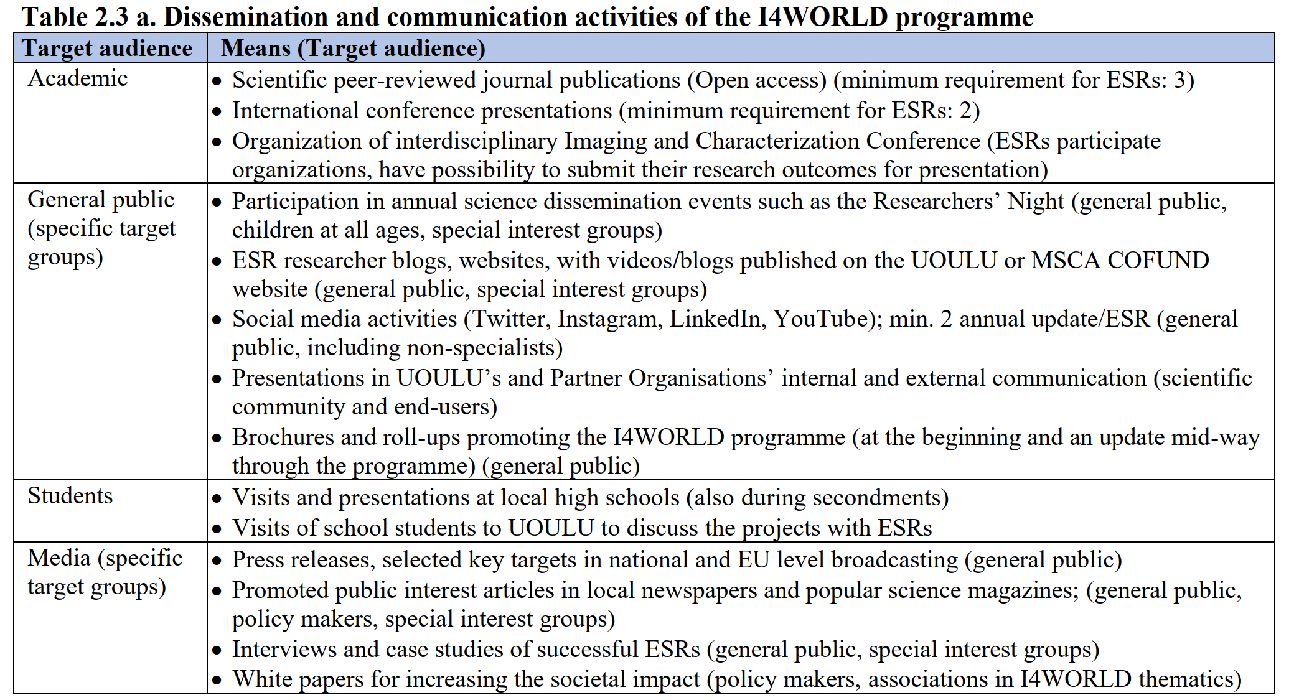

Slide 25

Open data
Projects of ESRs in I4WORLD will participate opening the data
In the data opening "as open as possible, as closed as necessary" -principle is followed
Data manager of I4WORLD: Minna Patanen and the data stewards of each faculty will help in practical matters
The ESRs and the supervisors will participate preparation of the Data Management Plan (DMP) in the beginning of the research projects
The DMP will be regularly updated during I4WORLD
Datasets underlaying the published papers will be made openly available in IDA and Allas or Eudat
(Rich) metadata will be stored in CSC Qvain or international data repository or archive that allows a persistent identifier and allows the data be citable.

Slide 26
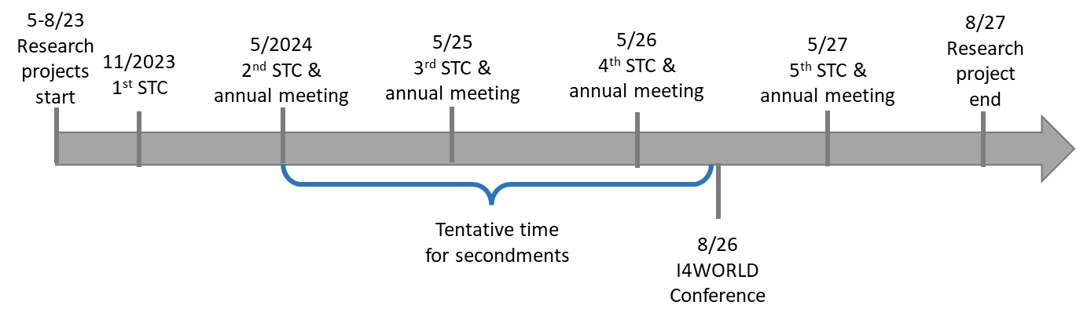
Schedule of the Programme
Supervisory board times aligned with annual meetings
(STC = Scientific Training Course)

Slide 27
Whats next ?
I4WORLD Programme:
Partner Guide (Latest 19.9)
Applicant Guide (Latest 1.11)
Supervisor Guide (End of Sept)
Website will open 1.11.
Units/Supervisors:
Unit descriptions (Done by 15.9)
Project definitions with partners by 10.10.
Possible contacts by applicants 1.11. - 31.1.
Remember:
International
Interdisciplinary
Intersectoral

Slide 28
I4WORLD
Imaging and Characterisation for a Sustainable World
Infosession 16.9.2022
H2020-MSCA-COFUND-DP I4WORLD – grant agreement preparation phase

