Slide 1

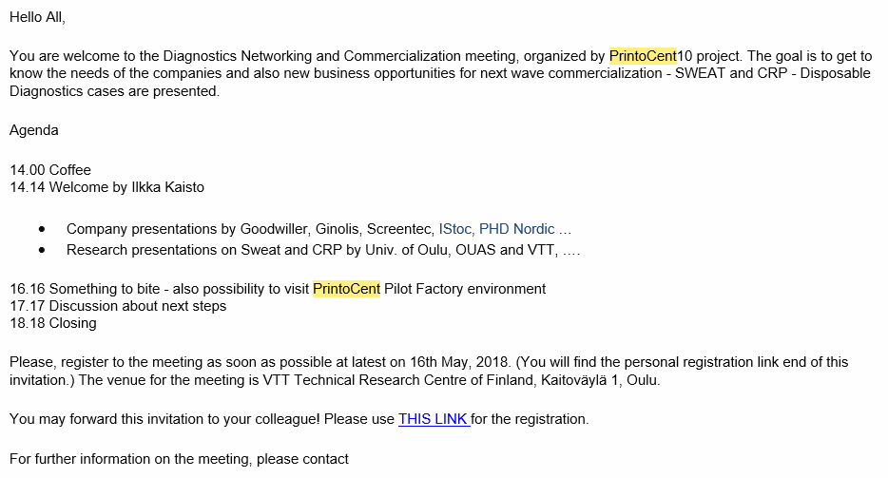
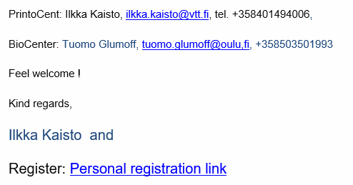

http://ulqr.mjt.lu/lnk/AKAABJIKm_AAAAAAAAAAAFtm8qwAAP-Kq4oAAAAAAAVvlQBa8re2jFkzXuPvTAm1soGPxxD7IQAFNnQ/3/rOzN5EuWzyoZGgKP-ZAJwA/aHR0cHM6Ly93d3cubHl5dGkuaW4vMjU0MjEyLTY5MTcxOTQxOA

